Slide 1

Week 1
Data Scientist Mindset

Slide 2
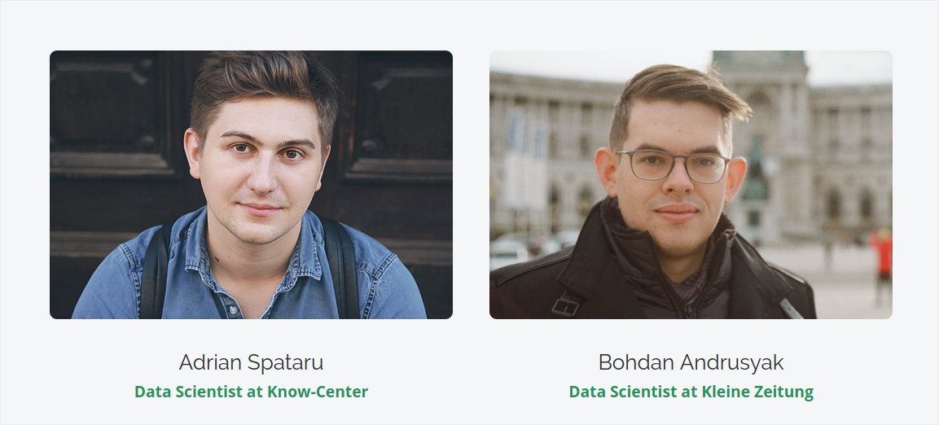
Introduction

Slide 3
Goal
Understand how to start and finish data science project
Have a finished Project for your Portfolio
Have the skillset of a junior data scientist

Slide 4
Agenda
What are the elements of data science?
Essential Statistics & Probability Refreshers
The importance of data in Data Science

Slide 5


Slide 6
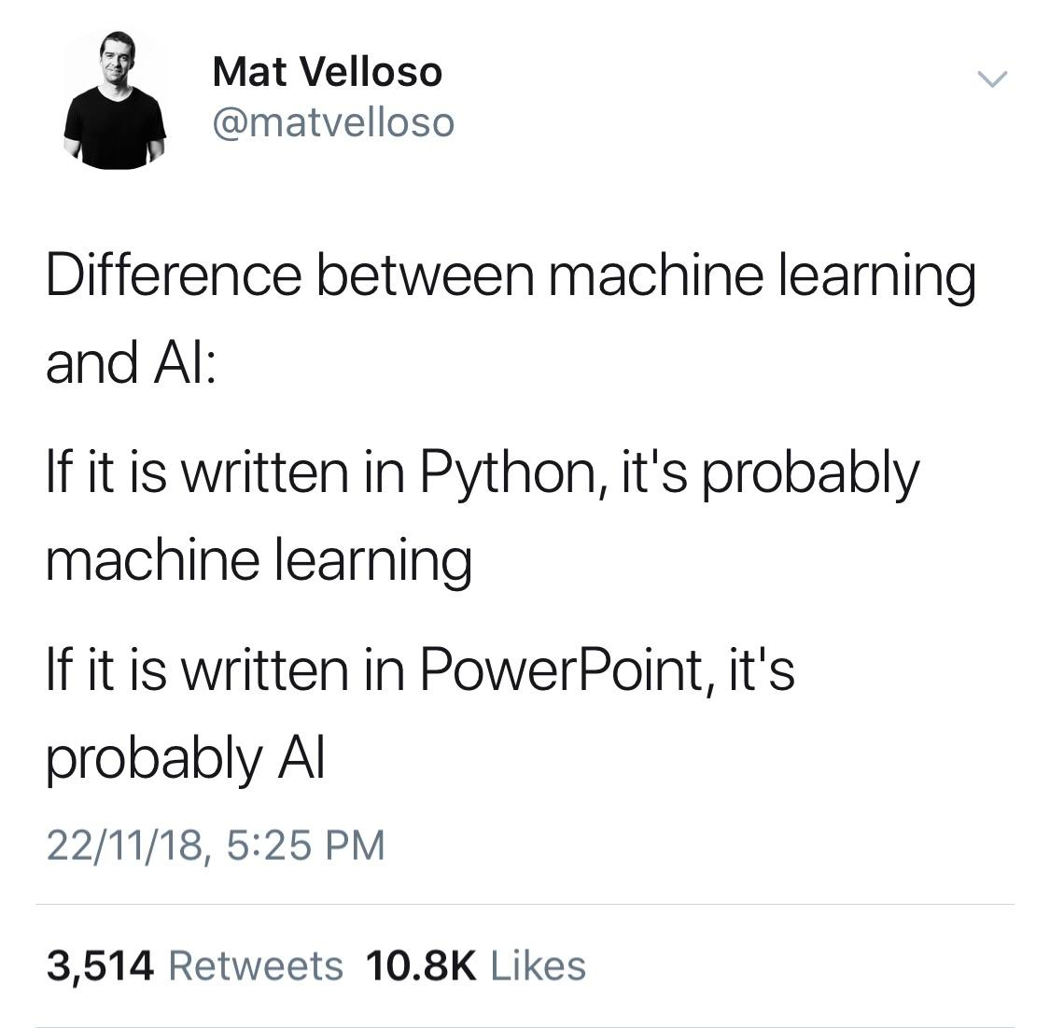

Slide 7
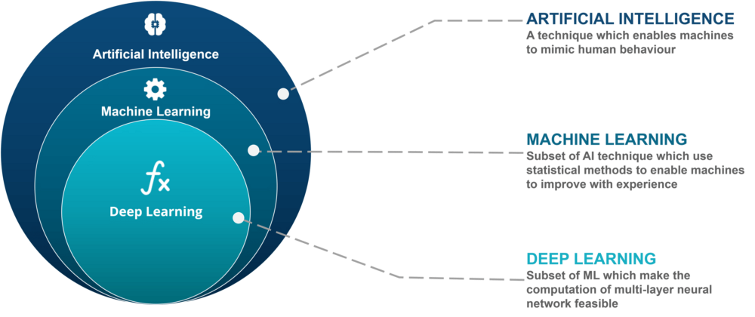

Slide 8
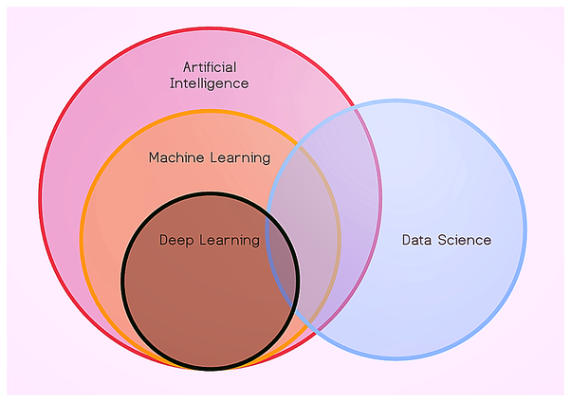

Slide 9
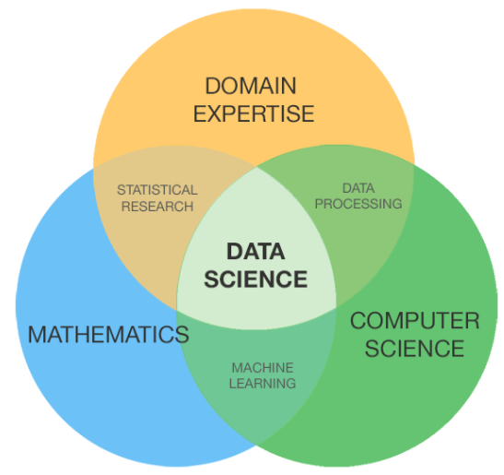
What has statistics to do with Data Science?

Slide 10

Statistics Fundamentals

Slide 11
Your Grades: 3,3,1,5
Mean: (3+3+1+5)/4 = 3

Slide 12
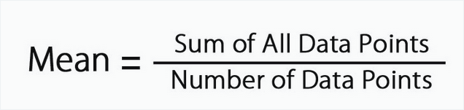
Your Grades: 3,3,1,5
Mean: (3+3+1+5)/4 = 3

Slide 13
Your Grades: 1,1,2,2,3

Slide 14
Your Grades: 1,1,2,2,3
Median = 2

Slide 15
Your Grades: 1,1,2,3,4,4
Median = (2+3)/2 = 2.5

Slide 16
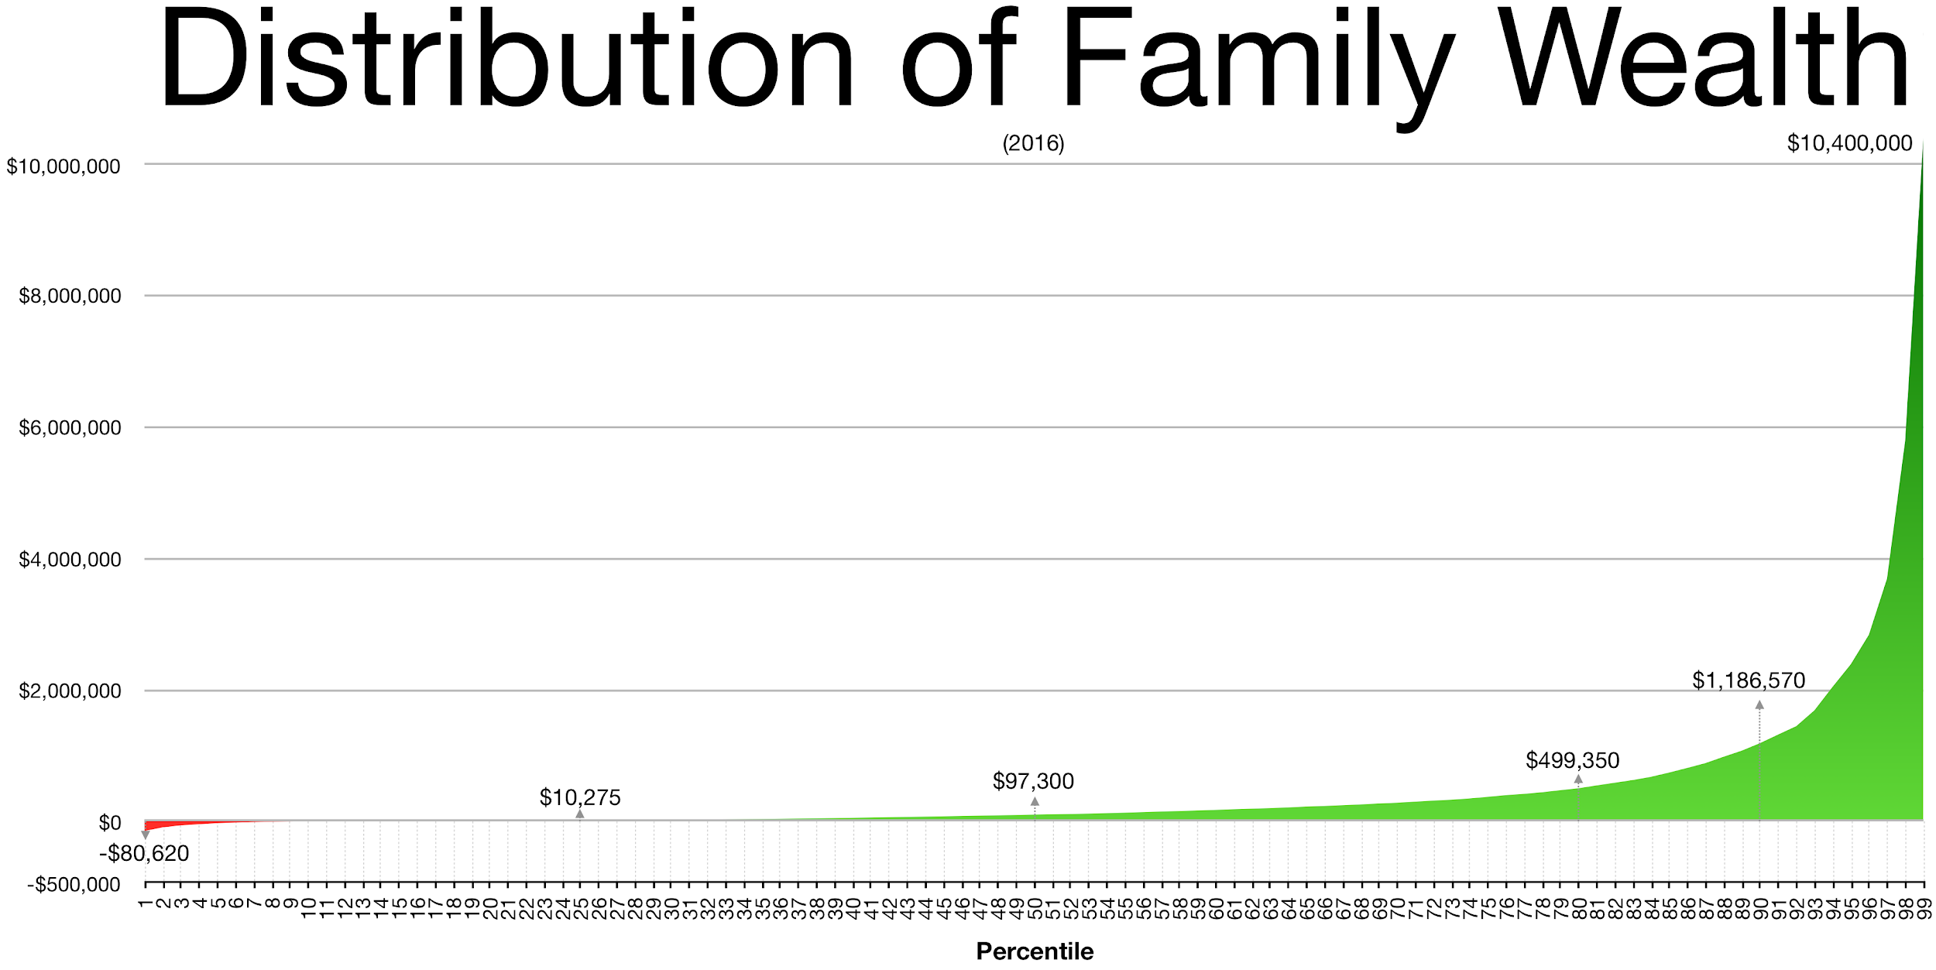

Slide 17
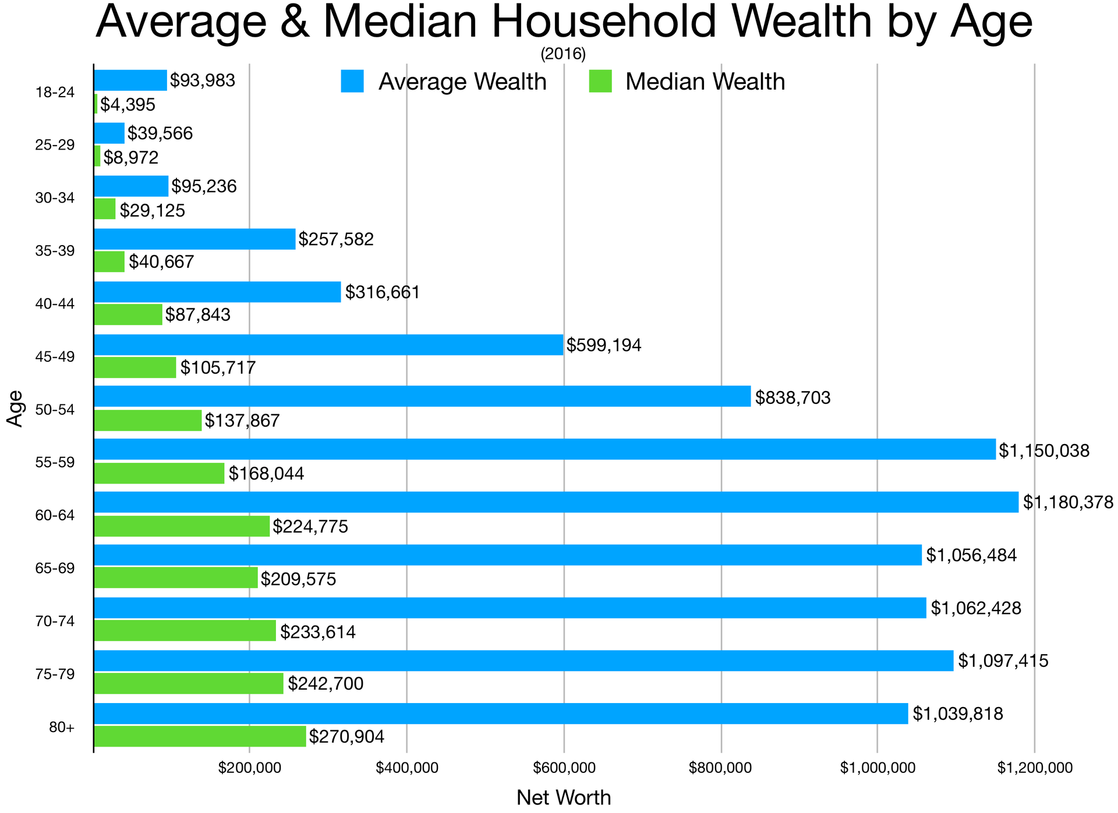

Slide 18
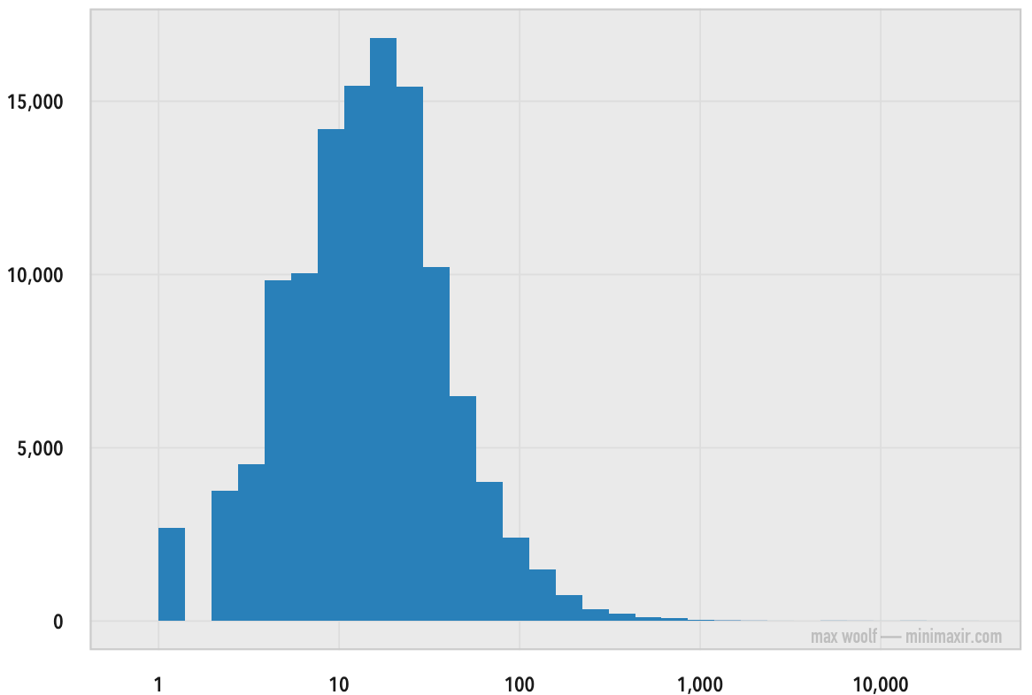
2016 - 140k Posts
Number of Posts
Number of Likes

Slide 19

Median: 23 Likes
Mean: 325 Likes

Slide 20
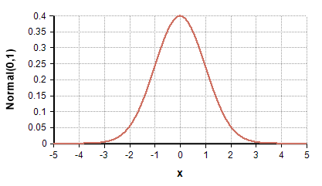
Gaussian Distribution

Slide 21
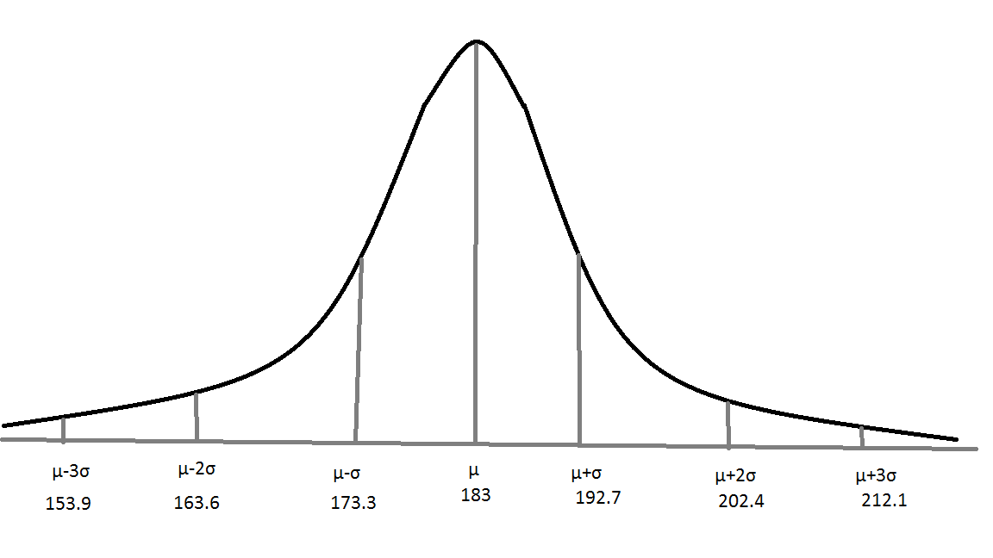
Height Distribution among Men

Slide 22
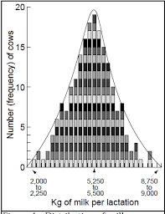
Volume of Milk Production From Cows

Slide 23
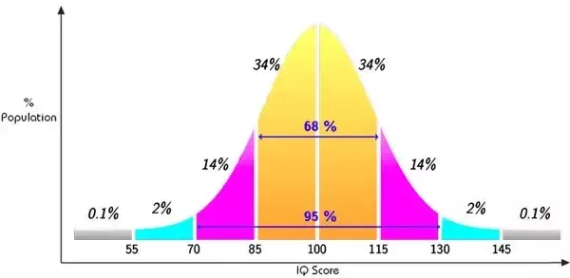
IQ Distribution

Slide 24
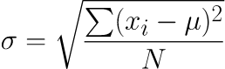
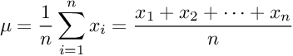
Standard Deviation
Mean

Slide 25


Slide 28
IQ Distribution

Slide 29
How smart are you if your IQ is 100?

Slide 30
How smart are you if your IQ is 100?
Your IQ is average, therefore you are
smarter than 50% of the people.

Slide 31
How smart are you if your IQ is 100?
Your IQ is average, therefore you are
smarter than 50% of the people.

Slide 32
How smart are you if your IQ is 110?

Slide 33
How smart are you if your IQ is 110?
Z-Score!

Slide 34
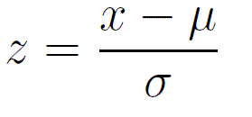
Z-Score
x = 110

Slide 35
Z-Score
x = 110
x = 100

Slide 36
Z-Score
x = 110
x = 100
x = 15

Slide 37
Z-Score
x = 110
x = 100
x = 15

Slide 38
Z-Score
x = 110
x = 100
x = 15

Slide 39
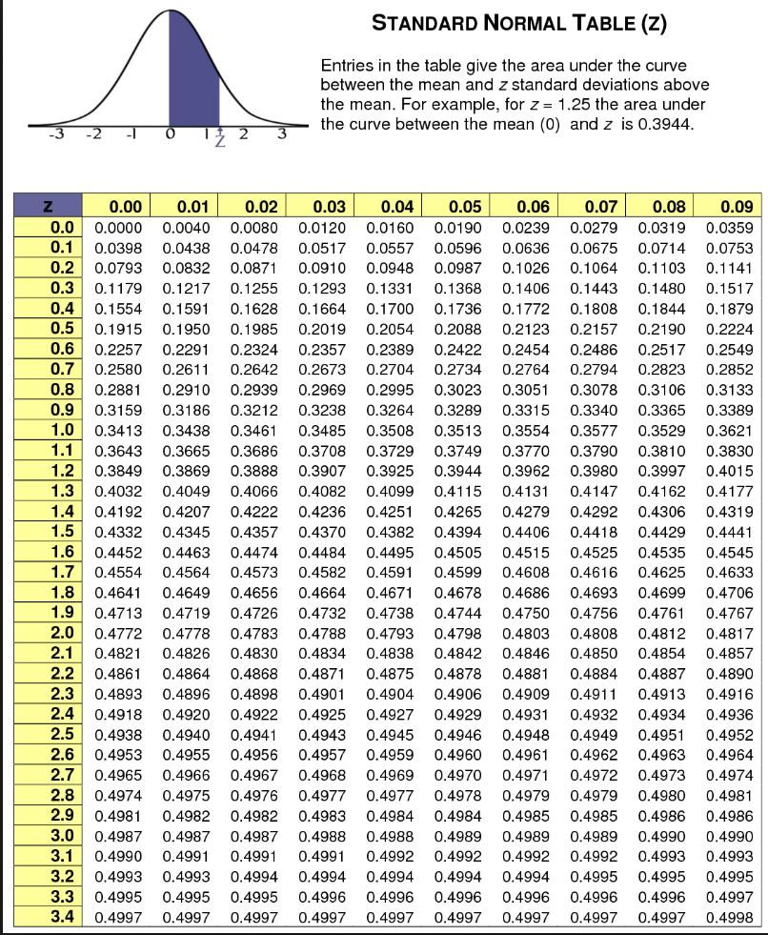
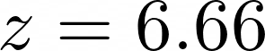
Z-Score table

Slide 40
Z-Score table

Slide 41
Z-Score table
0.2454

Slide 42
Z-Score table
0.2454 - What does that mean?

Slide 43
Z-Score table
0.2454 - What does that mean?
If you have a IQ of 110,
then you are 24.54% smarter than the
average person ( IQ 100).

Slide 44
Z-Score table
0.2454 - What does that mean?
If you have a IQ of 110,
then you are 24.54% smarter than the
average person ( IQ 100).
You are smarter than 74.54% of the people.
(0.5000+0.2454 = 0.7454)

Slide 45
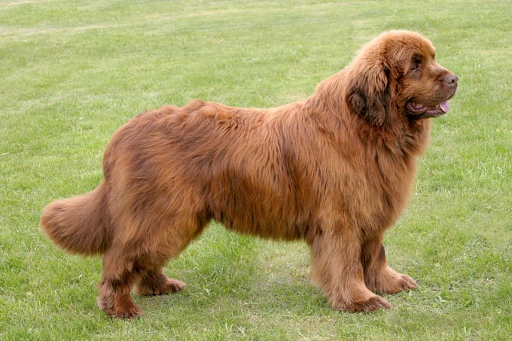
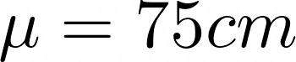
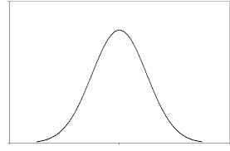
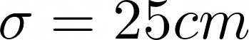
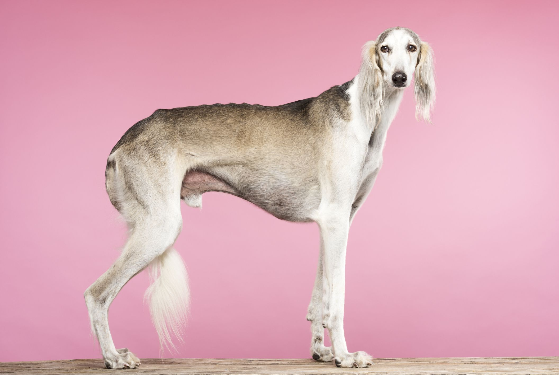

Height Distribution of all dog breeds

Slide 46
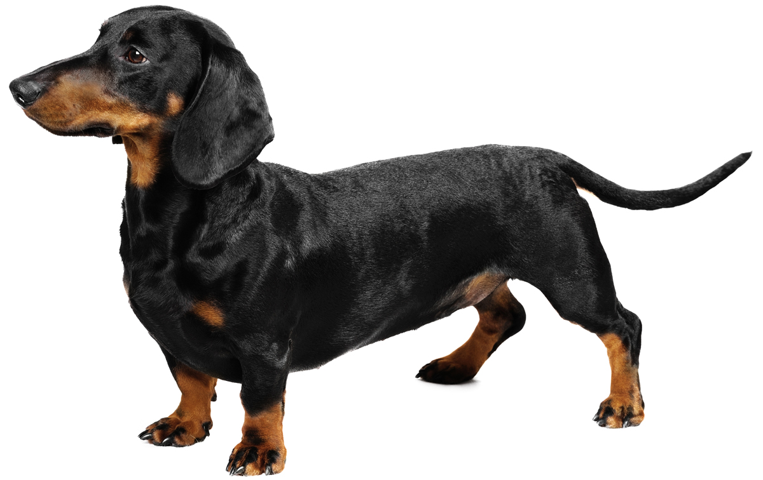
23 CM - Average Height

Slide 47
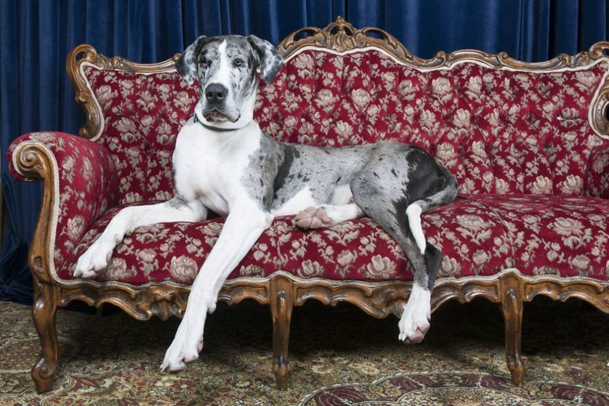
Great Dane
81CM - Average Height

Slide 48
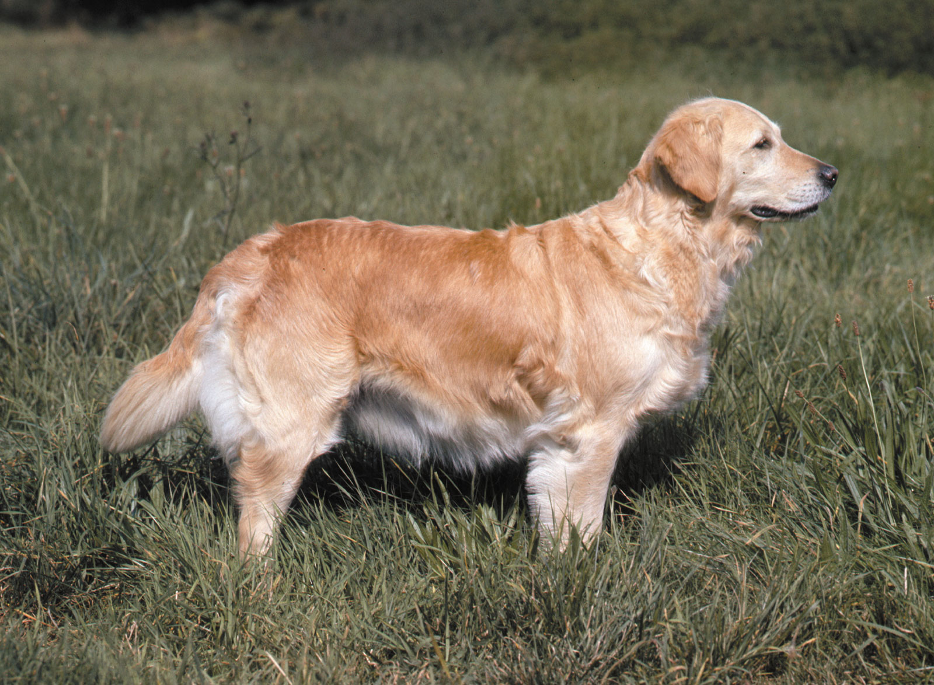
62CM - Average Height

Slide 49

Coin Flip example

Slide 50


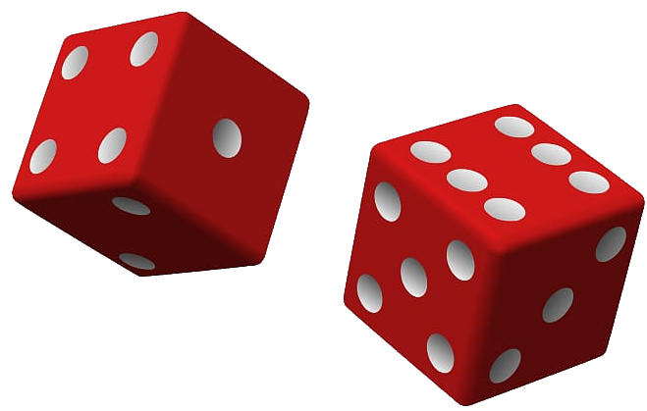
Probability
Probability is a numerical description of how likely an event is to occur.
Probability is a number between 0 and 1, where 0 indicates impossibility and 1 indicates certainty.

Slide 51
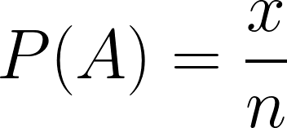
Probability Formula
P(A) - probability of event A occurring
x - number of favourable outcomes
n - number of total outcomes

Slide 52
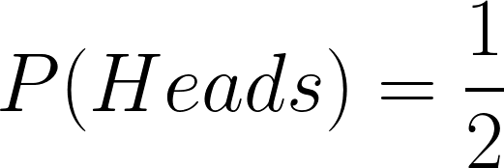
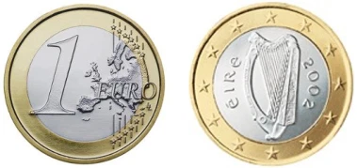
Coin Flip Example

Slide 53
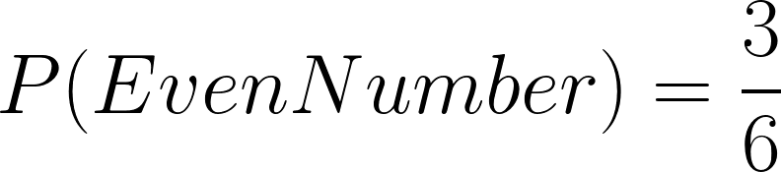
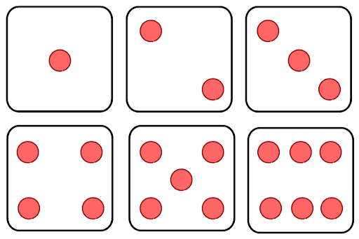
Dice Example

Slide 54
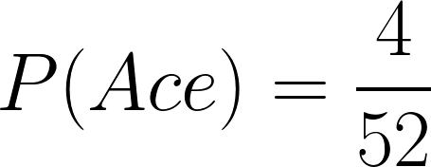
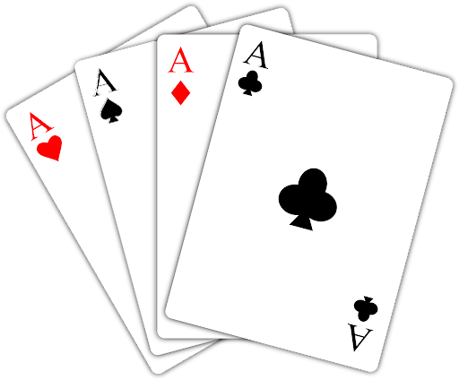
Cards Example

Slide 55
quiz: probability number card

Slide 56
quiz: prob. of a certain suit

Slide 57
The Addition Rule
Probability of two events that are NOT mutually exclusive

Slide 58
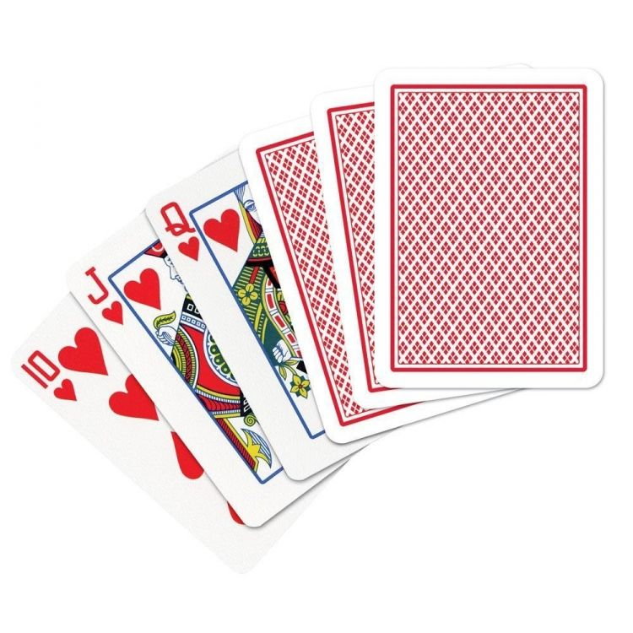
Cards Example

Slide 59
Cards Example

Slide 60
Independent Events
An independent event is an event that has no connection to another event’s chances of happening.
The event has no effect on the probability of another event occurring.
Examples:
Flipping multiple coins
Rolling multiple dices
Seeing black cat and failing your exam

Slide 61
The Multiplication Rule
Probability of two independent event occurring together

Slide 62

Snake Eyes Example

Slide 63
Dependent Events
When two events are dependent events, one event influences the probability of another event
A dependent event is an event that relies on another event to happen first
Examples:
Learning data science and getting well-paid job
Breaking quarantine and getting COVID-19
Buying ten lottery tickets and winning the lottery.

Slide 64
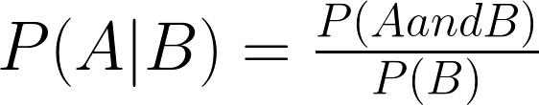
Conditional Probability
Probability of event A occurring given event B has occurred

Slide 65
High Paid Job Example
P(A) - probability of having high paid job

Slide 66
High Paid Job Example
P(A) - probability of having high paid job
P(B) - probability of being Data Scientist = 1/30

Slide 67
High Paid Job Example
P(A) - probability of having high paid job
P(B) - probability of being Data Scientist = 1/30
P(AandB) - probability of being Data Scientist and having high paid job = 1/50

Slide 68
High Paid Job Example
P(A) - probability of having high paid job
P(B) - probability of being Data Scientist = 1/30
P(AandB) - probability of being Data Scientist and having high paid job = 1/50
P(A|B) - probability of Data Scientist having high paid job

Slide 69
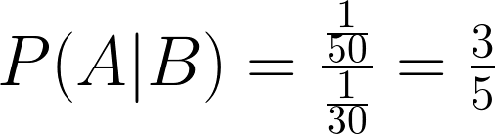
High Paid Job Example
P(A) - probability of having high paid job
P(B) - probability of being Data Scientist = 1/30
P(AandB) - probability of being Data Scientist and having high paid job = 1/50
P(A|B) - probability of Data Scientist having high paid job

Slide 70
What is the probability of 3?

Slide 71
What is the prob. of 7?

Slide 72
quiz: what prob. of 7?

Slide 73
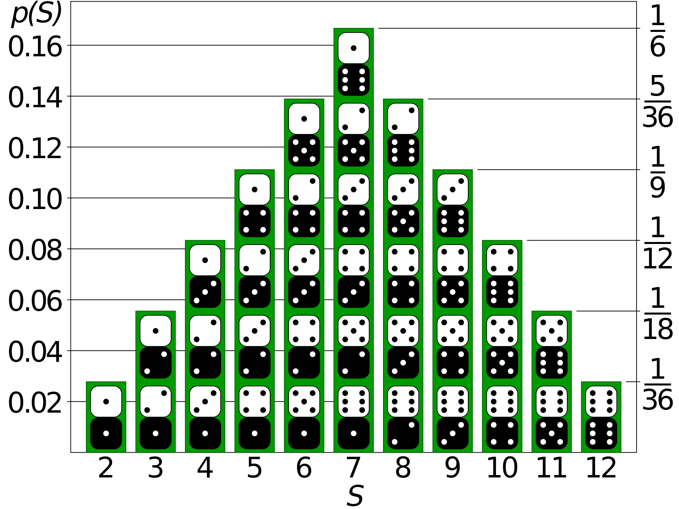


Slide 74



Slide 75
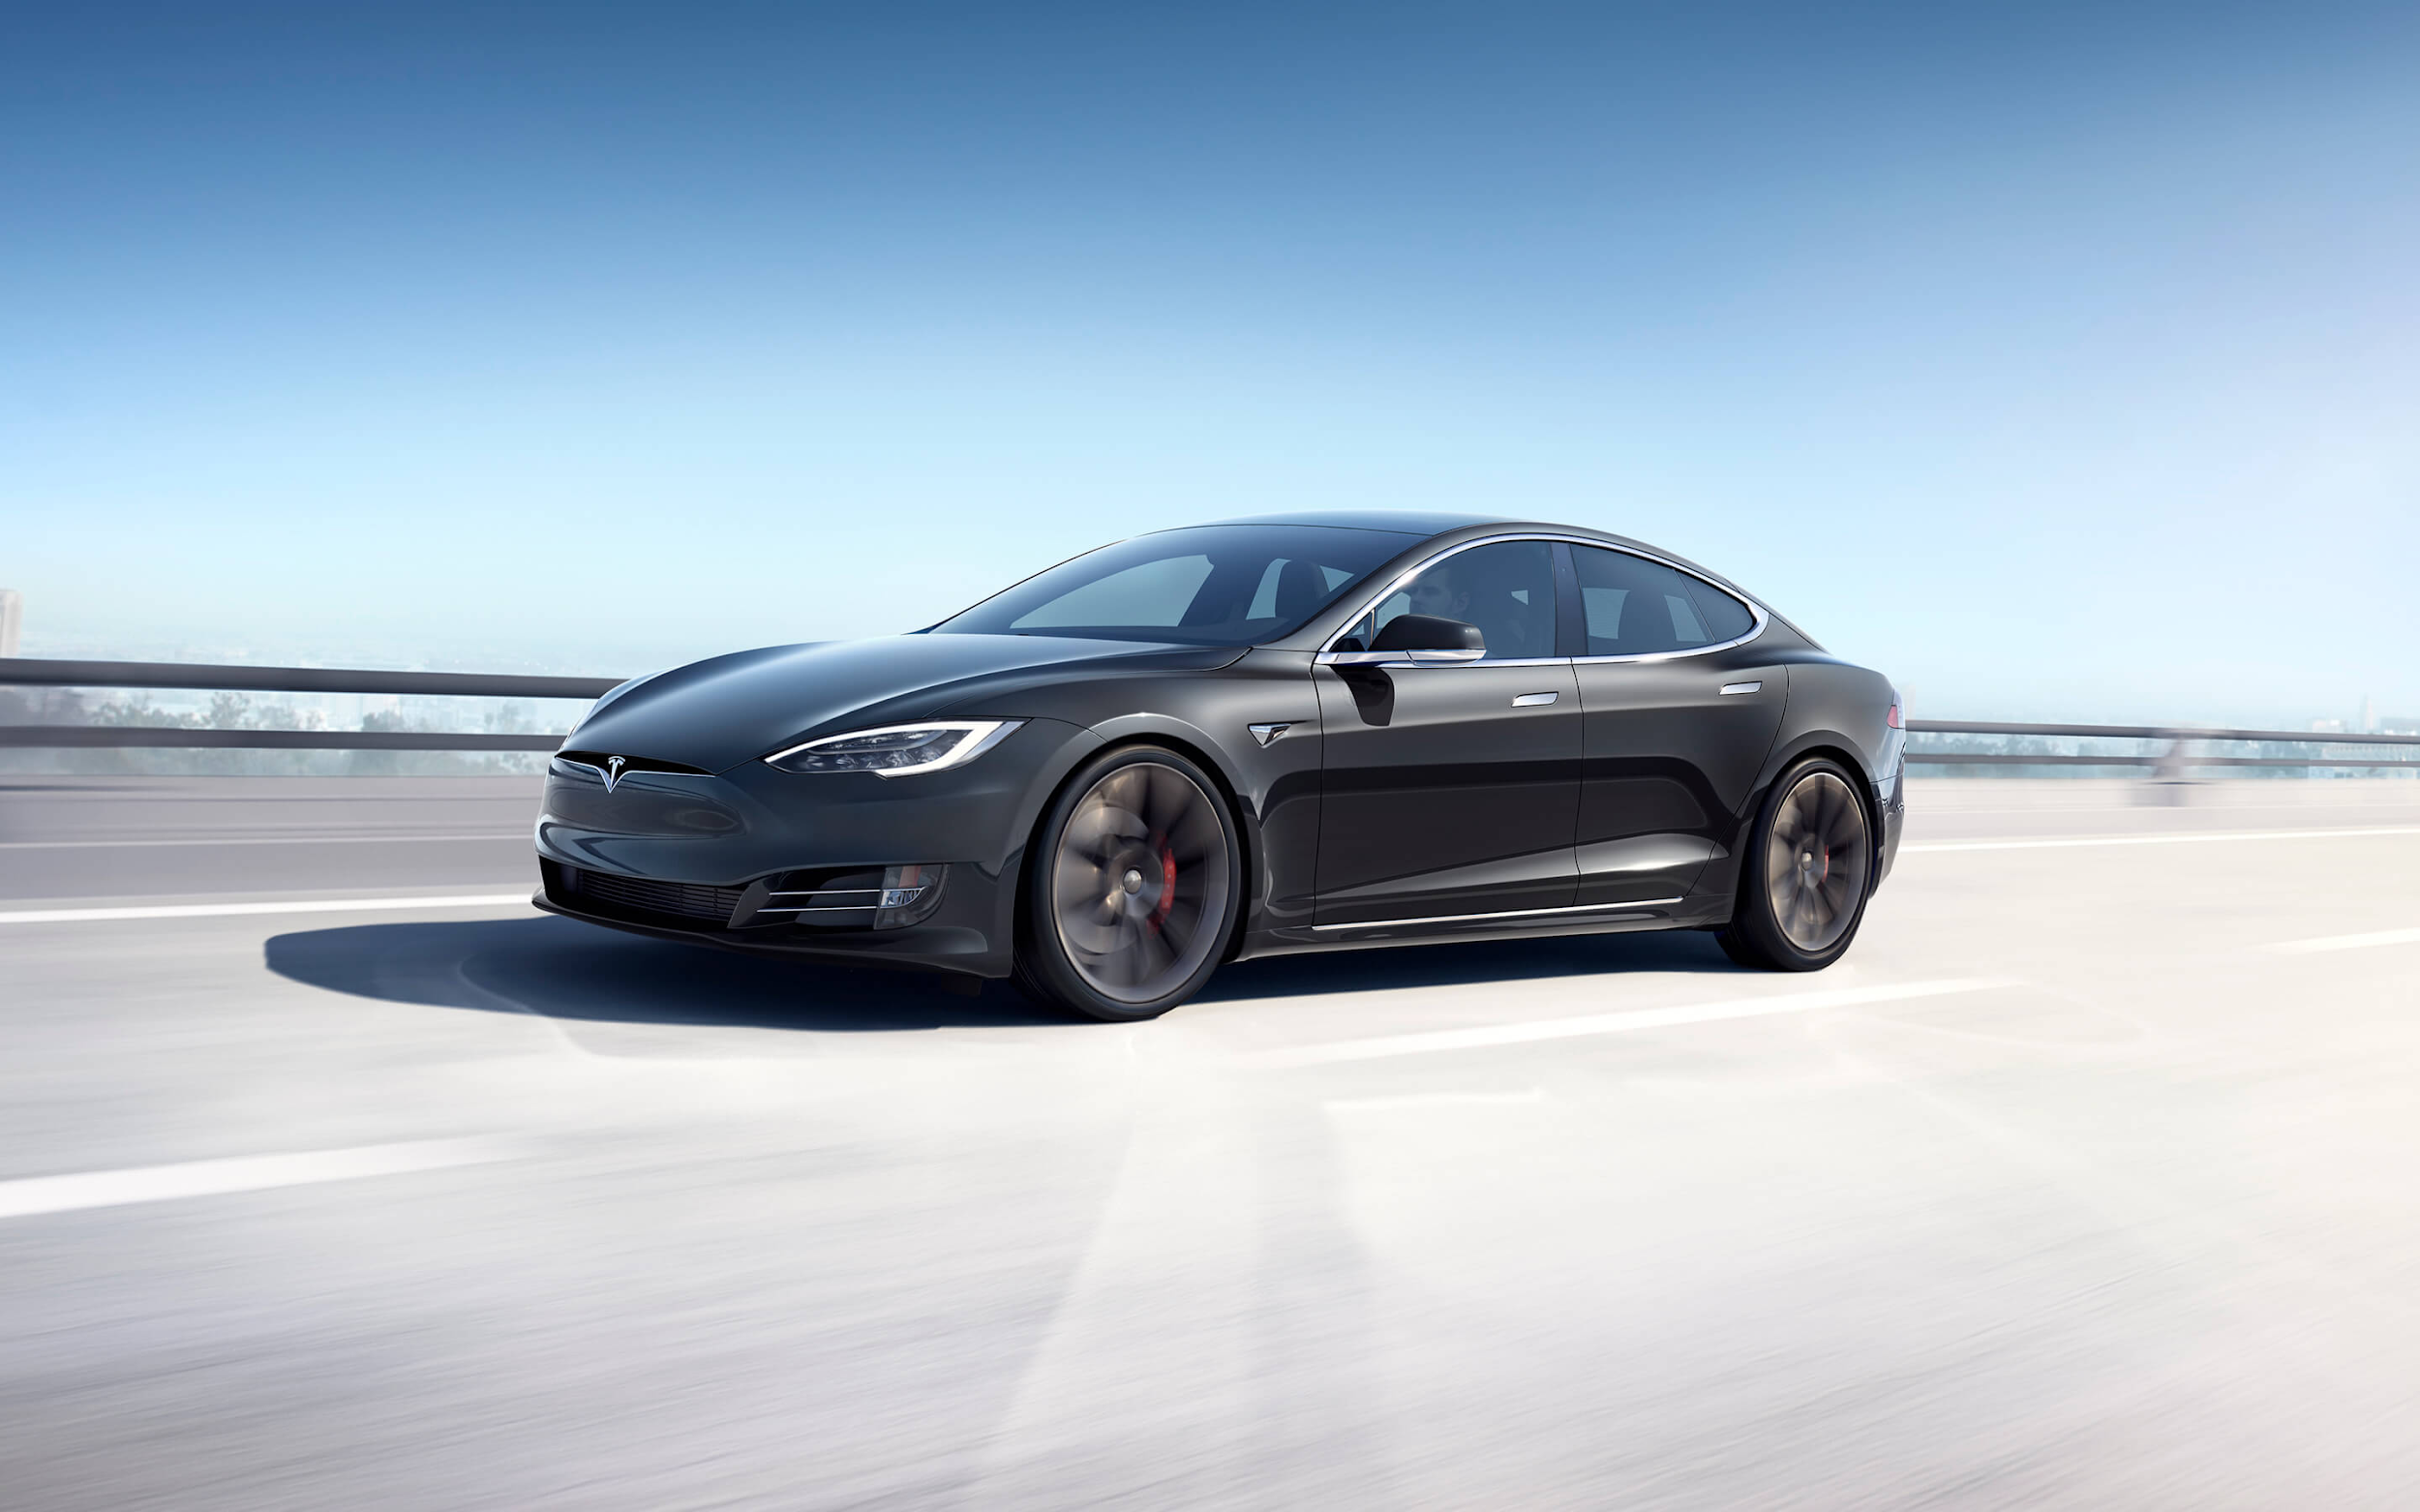

Slide 76
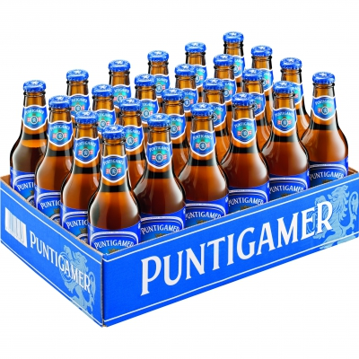

Slide 77


Slide 78


Slide 82


Slide 84
50%
50%

Slide 87
33.3%
66.6%

Slide 88
33.3%
66.6%

Slide 89
33.3%
33.3%
33.3%

Slide 90
Door selection
P(Beer) = ⅔ = 66.6%
P(Car) = ⅓ = 33.3%

Slide 91
Keep or Switch?
Keeping:
P(Car|Beer) = 1/3 = 33.3%
P(Beer|Beer) = 2/3 = 66.6%

Slide 94
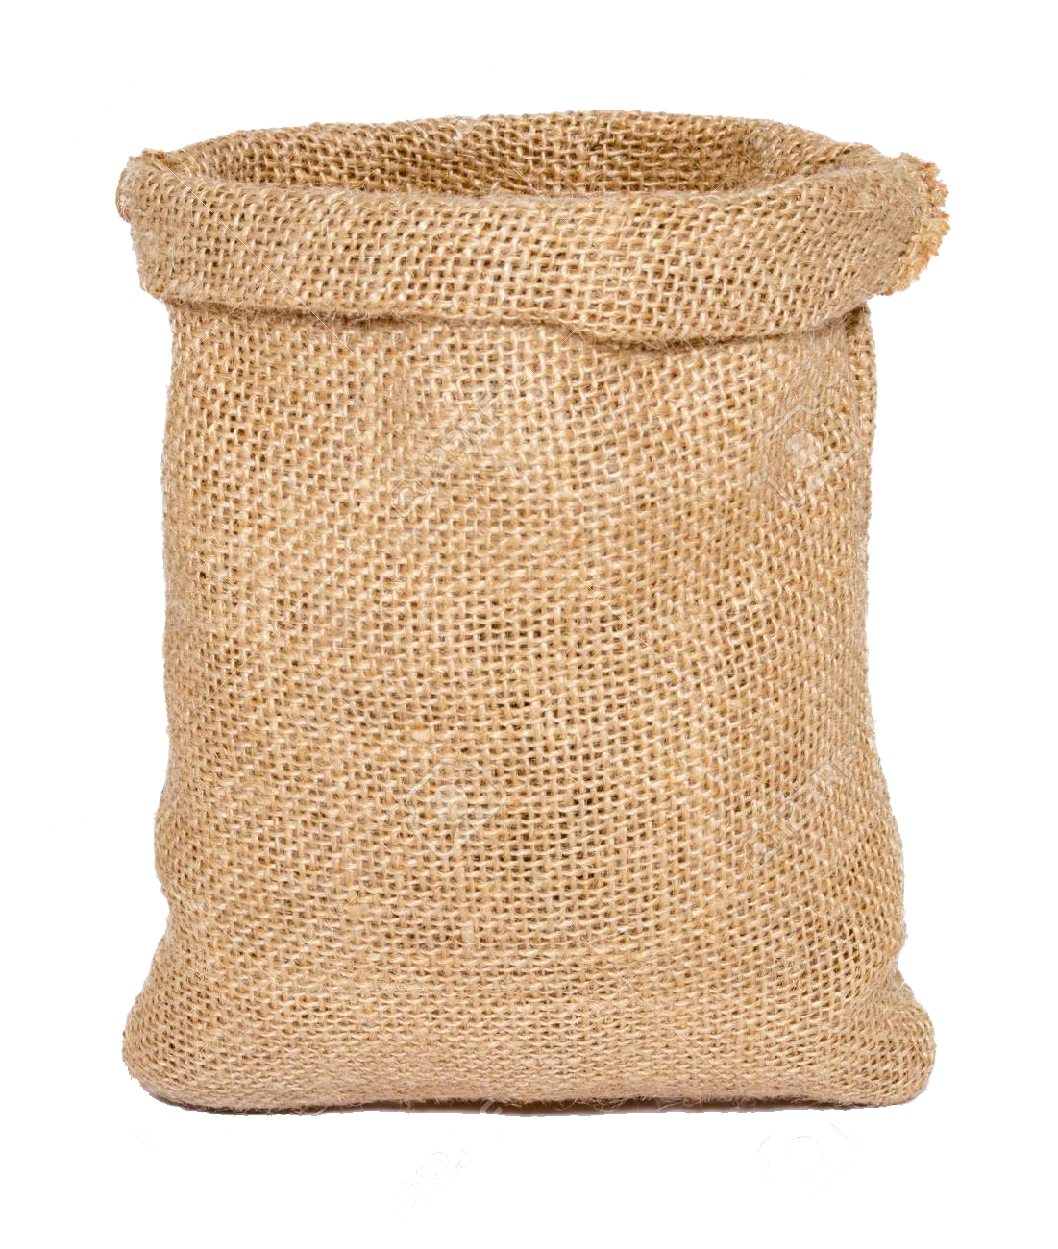

Slide 95


x10
x5

Slide 96
Probability of first marble red?

Slide 97
Probability of first marble red?
10/15 = 66.6%

Slide 98
15 Marbles
10 Desired outcomes

Slide 99
Probability of 2 marble red?
10/15 * 9/14 = 42.8%

Slide 100
15 Marbles
10 Desired outcomes

Slide 101
14 Marbles
9 Desired outcomes

Slide 102
quiz:balls examples

Slide 103
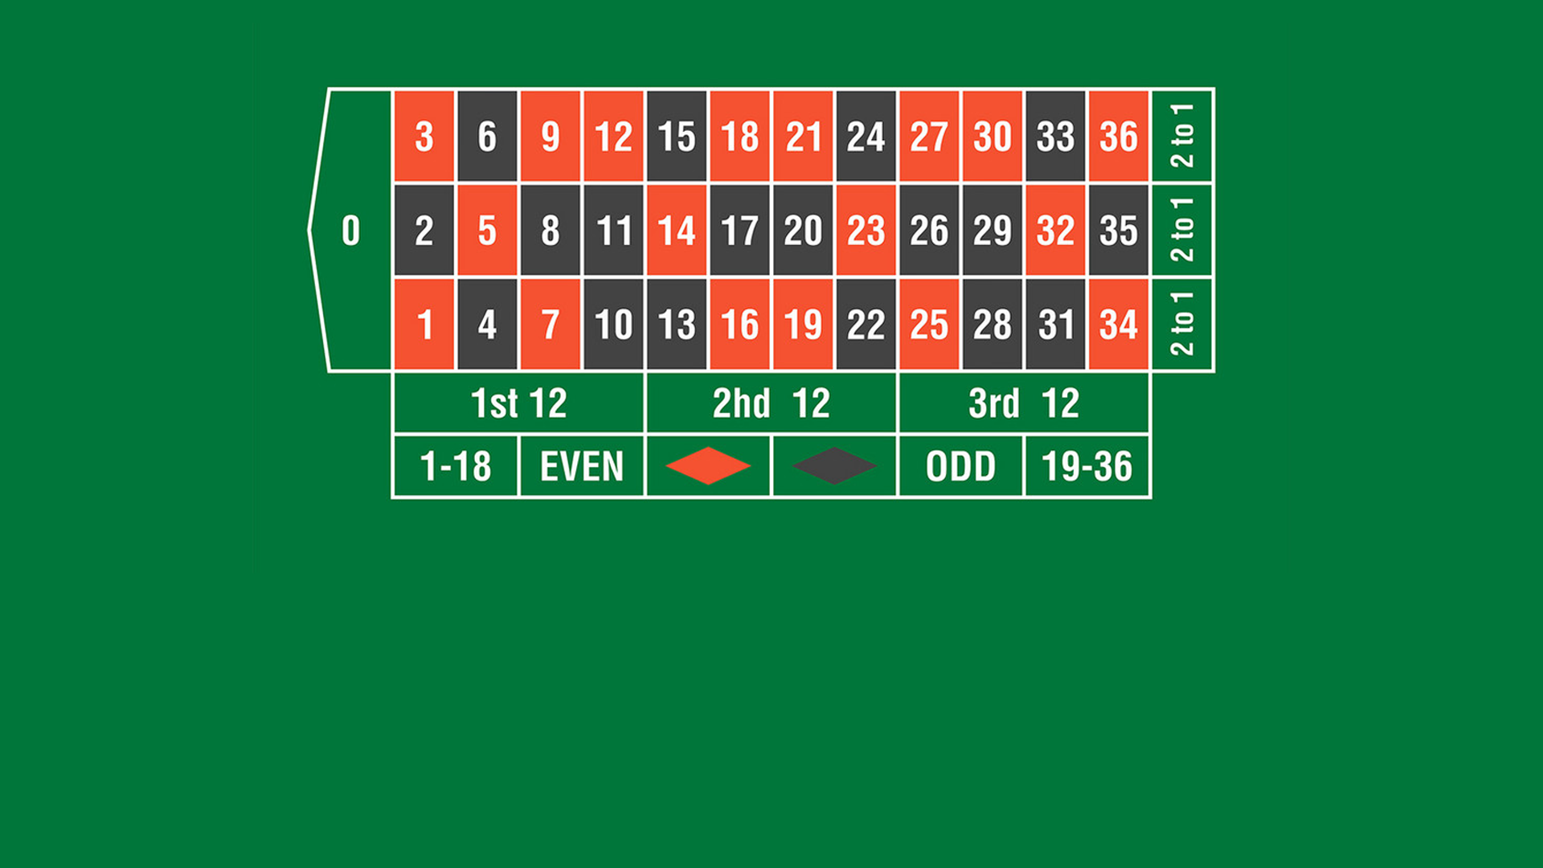
Last 10 Games it was:

Slide 104
Last 10 Games it was:
What is the probability that is on the next turn?

Slide 105
37 Outcomes
18 Desired
= 18/37 = 48.6%

Slide 106
Break

Slide 107


Slide 108

What is data?
Data is a collection of facts, such as numbers, words, measurements, observations or even just descriptions of things.

Slide 109
Data Types
Data
Qualitative
Quantitative

Slide 110
Data Types
Data
Qualitative
Quantitative
Excellent Data Science course
Big soda cup
Male
10
500 ml
3.625, 1.234, 5.223 ...

Slide 111
Quantitative Data Types
Quantitative Data
Discrete
Continuous
Based on counting
Finite amount values
Based on measuring
Can take any value (within a range)

Slide 112
Qualitative Data Types
Qualitative Data
Nominal
Ordinal
Used to label variables
Can not be ordered or measured
Follow natural order
Differences between the data values cannot be determined or are meaningless.

Slide 113
Data Types
Data
Qualitative
Quantitative
Nominal
Ordinal
Discrete
Continuous

Slide 114
Example Apartment Data
Street Name | Amount of Rooms | Area | Type | Price
Glacisstrasse | 5 | 220 | Luxury | 2500000
Inffeldgasse | 3 | 120 | Standart | 450000
Kasernstrasse | 2 | 45 | Econom | 100000
Kreuzgasse | 6 | 250 | Luxury | 3000000

Slide 115
Example Apartment Data
Street Name | Amount of Rooms | Area | Type | Price
Glacisstrasse | 5 | 220 | Luxury | 2500000
Inffeldgasse | 3 | 120 | Standart | 450000
Kasernstrasse | 2 | 45 | Econom | 100000
Kreuzgasse | 6 | 250 | Luxury | 3000000
Nominal
Discrete
Continuous
Ordinal
Continuous

Slide 116
What about Postal Code?
Postal Code
8010
8010
8041
8020

Slide 117
Predicting Price
Amount of Rooms | Price
3 | 125000
1 | 52000
2 | 75000
4 | 148000

Slide 118
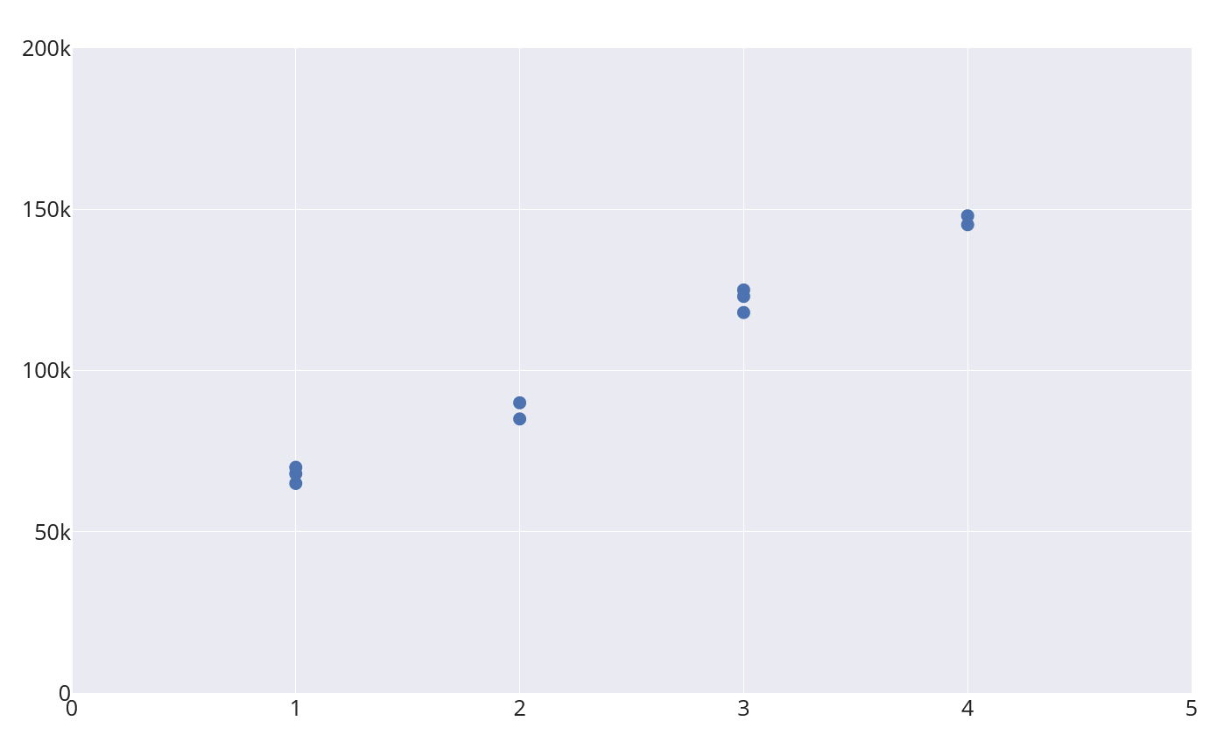
Linear Regression - House Price/Number Rooms

Slide 119
Linear Regression - House Price/Number Rooms

Slide 120
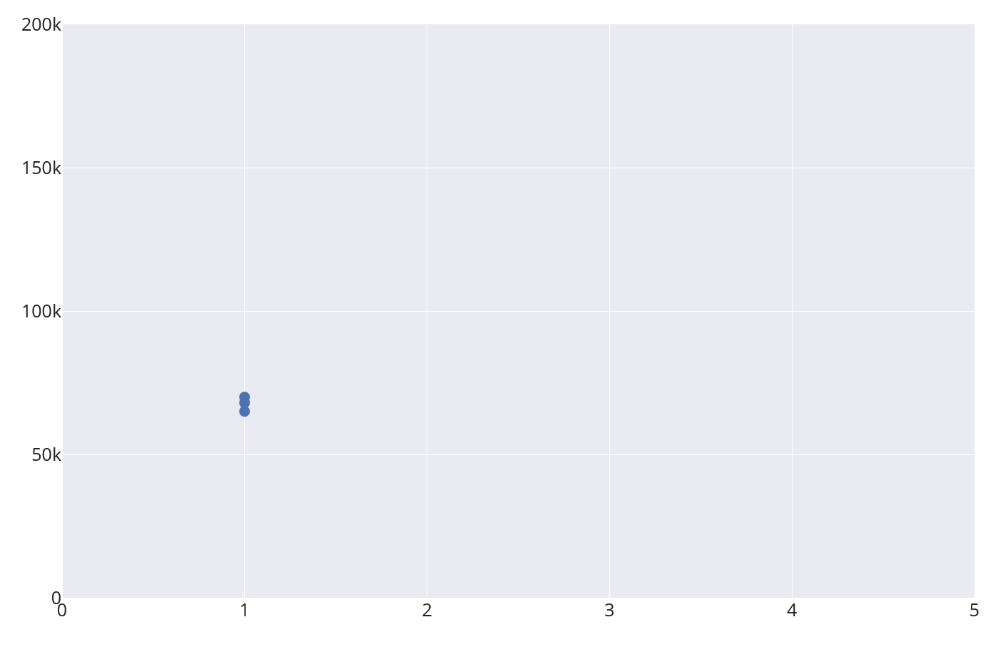

Slide 124
How much
data do we need?

Slide 125
How much
data do we need?
Depends on the Problem.

Slide 126
https://giphy.com/videos/ConnectedMovie-sony-connected-movie-fUNQhFbC05DMRwCYPF

Slide 127


Slide 128

99% Dog

Slide 129
How much data for
Image Classifier?
~ 1000 images per Class

Slide 130
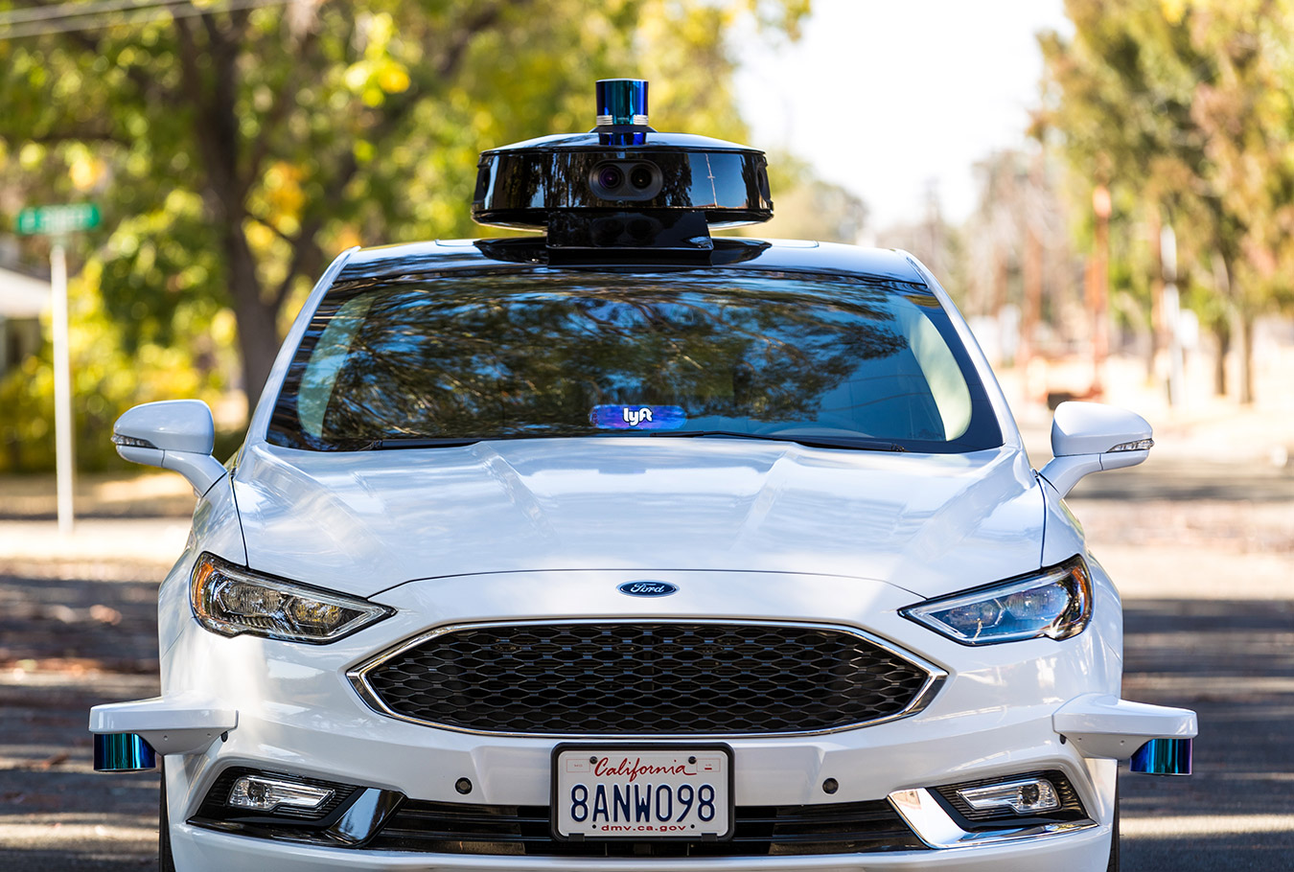
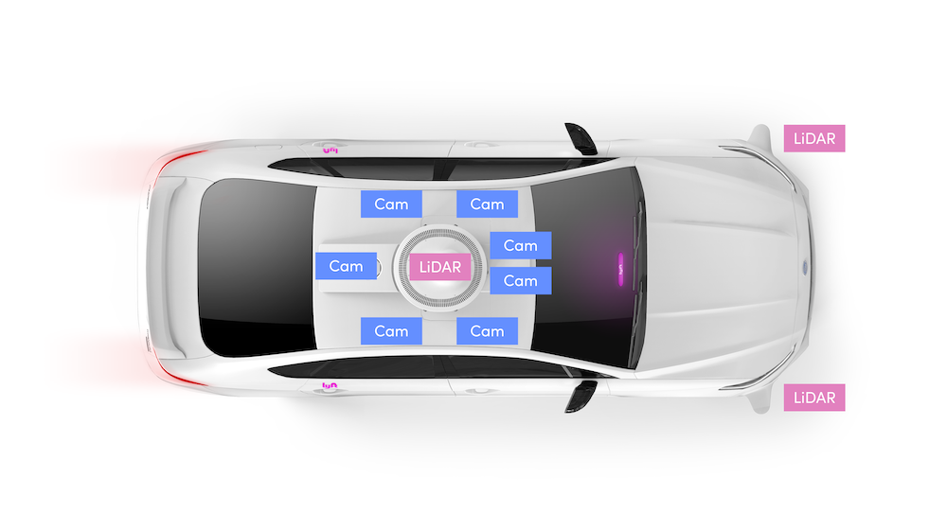

Slide 131
https://level5.lyft.com/wp-content/uploads/2019/06/allcams_example.mp4
VIDEO

Slide 132
How much data for Self-driving car?

Slide 133
How much data for Self-driving car?
~2080 Hours Waymo (Self-driving Car Company)

Slide 134
How much data for
Language Translation?

Slide 135
How much data for
Language Translation?
English - French
2,007,723 Sentences

Slide 136





Data Science Pipeline
Data
Wrangle
Explore
Model
Report

Slide 137
Assignment
Fill up the Quiz (will get it through mail)
Have a Gmail Account until next week

Slide 138
Next week Preview
Work on real life datasets
Learn how to answer questions with data
Understand the fundamentals of cleaning your data

Slide 139



Slide 140


